Slide 1
Gradient Descent
The content of these slides has been gathered from various online sources. We extend our sincere gratitude to everyone who has contributed their work.

Slide 2
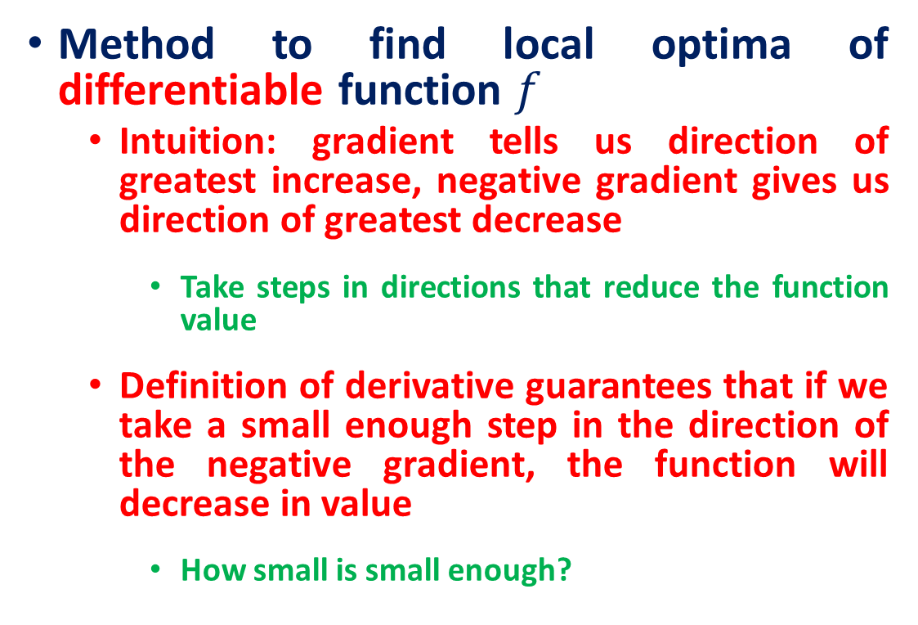
Gradient Descent
Method to find local optima of differentiable function $f$
Intuition: gradient tells us direction of greatest increase, negative gradient gives us direction of greatest decrease
Take steps in directions that reduce the function value
Definition of derivative guarantees that if we take a small enough step in the direction of the negative gradient, the function will decrease in value
How small is small enough?

Slide 3


Gradient Descent
Gradient Descent Algorithm:
Pick an initial point $x_{0}$
Iterate until convergence
$$x^{\left(t+1\right)}=x^{\left(t\right)}−α^{(t)}∇f(x^{\left(t\right)})$$
where $α^{(t)}$ is the $t^{th}$ step size (learning rate)
When do we stop?
Possible Stopping Criteria: iterate until $\left\|∇f(x^{(t)})\right\|≤ε$ for some $ε>0$
How small should $ε$ be?

Slide 4
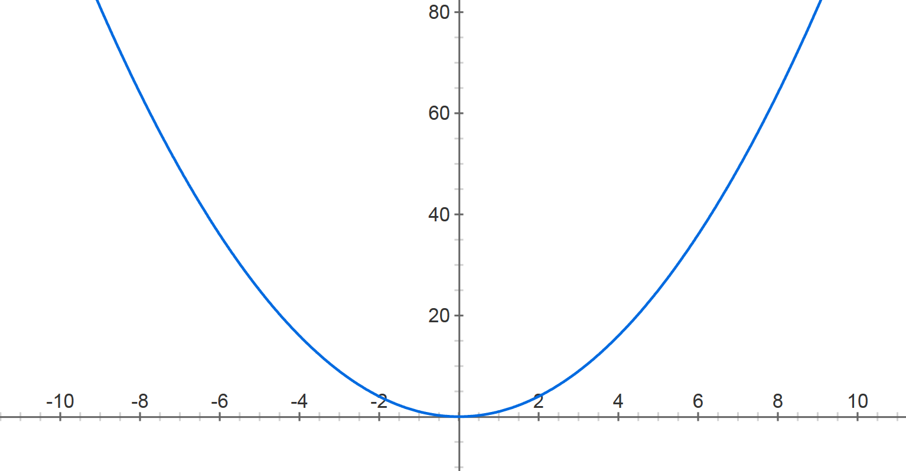



Gradient Descent
$$f\left(x\right)=x^{2}$$
Step size: $.8$
$$x^{(0)}=−4$$

Slide 5


Gradient Descent
$$f\left(x\right)=x^{2}$$
Step size: $.8$
$$x^{(0)}=−4$$
$$x^{(1)}=−4− .8⋅2⋅(−4)$$

Slide 6

Gradient Descent
$$f\left(x\right)=x^{2}$$
Step size: $.8$
$$x^{(0)}=−4$$
$$x^{(1)}=2.4$$

Slide 7





Gradient Descent
$$f\left(x\right)=x^{2}$$
Step size: $.8$
$$x^{(0)}=−4$$
$$x^{(1)}=2.4$$
$$x^{(2)}=2.4− .8⋅2⋅2.4$$
$$x^{(1)}=0.4$$

Slide 8

Gradient Descent
$$f\left(x\right)=x^{2}$$
Step size: $.8$
$$x^{(0)}=−4$$
$$x^{(1)}=2.4$$
$$x^{(2)}=−1.44$$

Slide 9





Gradient Descent
$$f\left(x\right)=x^{2}$$
Step size: $.8$
$$x^{(0)}=−4$$
$$x^{(1)}=2.4$$
$x^{(2)}=−$1.44
$$x^{(3)}=.864$$
$$x^{(4)}=−0.5184$$
$$x^{(5)}=0.31104$$
$$x^{(30)}=−8.84296e−07$$

Slide 10
Gradient Descent
If the learning rate is big, the weights slosh to and fro across the ravine.
If the learning rate is too big, this oscillation diverges.
What we would like to achieve:
Move quickly in directions with small but consistent gradients.
Move slowly in directions with big but inconsistent gradients.
Step size: .9

Slide 11
Gradient Descent
Step size: .2

Slide 12
Gradient Descent
Step size matters!

Slide 13
Gradient Descent
Step size matters!

Slide 14
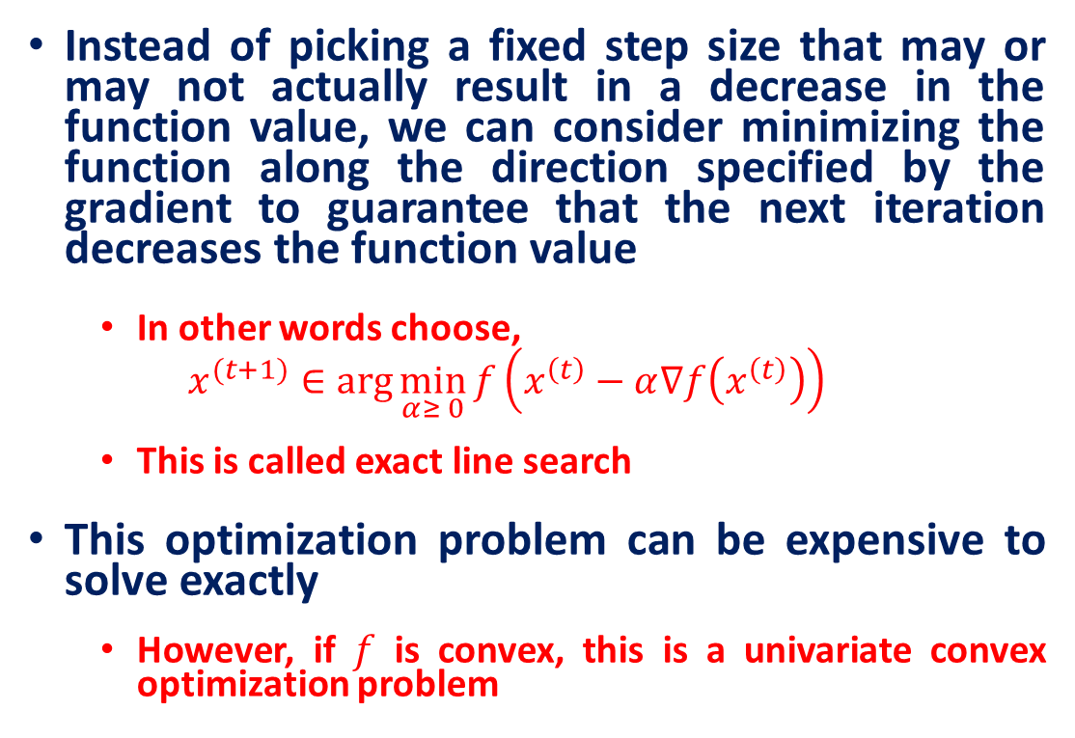
Line Search
Instead of picking a fixed step size that may or may not actually result in a decrease in the function value, we can consider minimizing the function along the direction specified by the gradient to guarantee that the next iteration decreases the function value
In other words choose,
$$x^{(t+1)}∈\arg{\min_{α≥ 0}{f\left(x^{\left(t\right)}−α∇f\left(x^{\left(t\right)}\right)\right)}}$$
This is called exact line search
This optimization problem can be expensive to solve exactly
However, if $f$ is convex, this is a univariate convex optimization problem

Slide 15
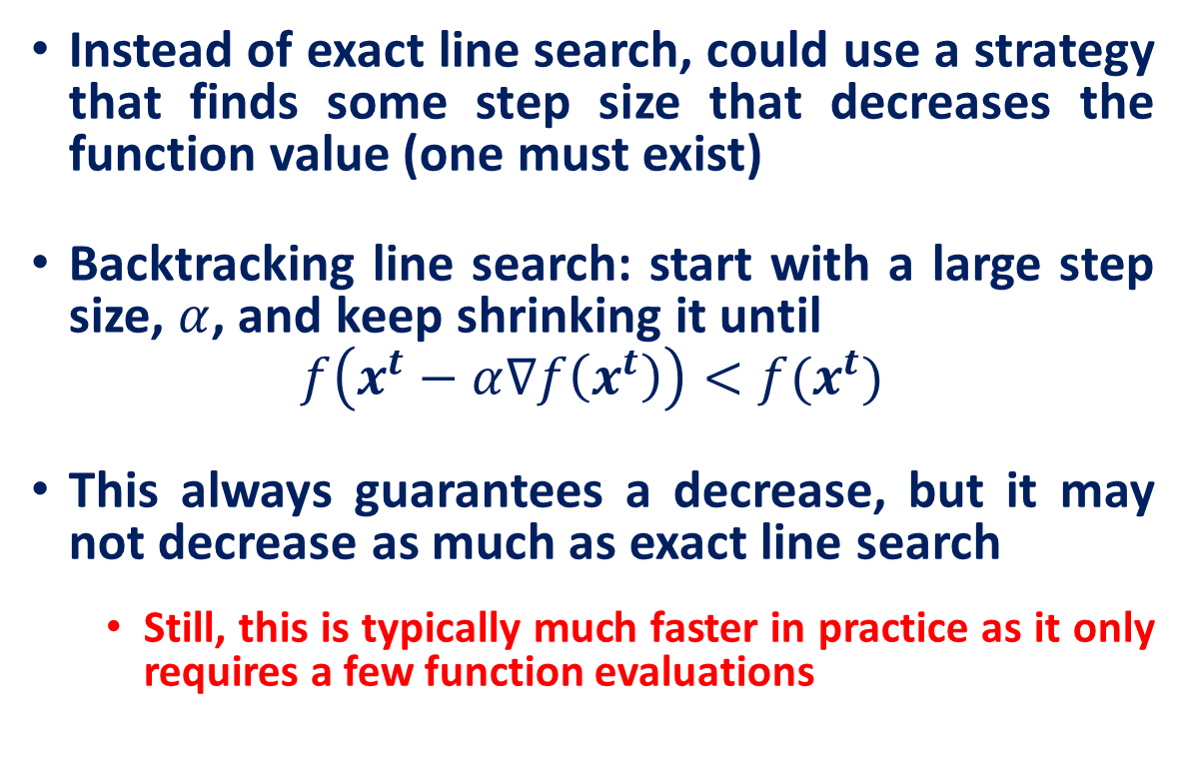
Backtracking Line Search
Instead of exact line search, could use a strategy that finds some step size that decreases the function value (one must exist)
Backtracking line search: start with a large step size, $α$, and keep shrinking it until
$$f\left(x^{t}−α∇f\left(x^{t}\right)\right)<f(x^{t})$$
This always guarantees a decrease, but it may not decrease as much as exact line search
Still, this is typically much faster in practice as it only requires a few function evaluations

Slide 16
Backtracking Line Search
To implement backtracking line search, choose two parameters$β∈(0,1)$
Set $α=1$
While
$f\left(x^{(t)}−α∇f\left(x^{(t)}\right)\right)> f\left(x^{(t)}\right)−α⋅{\left\|∇f\left(x^{(t)}\right)\right\|}^{2}$
$α=βα$
Set $x_{t+1}=x_{t} −α∇f\left(x_{t}\right)$
Iterations continue until a step size is found that decreases the function “enough”

Slide 17

Backtracking Line Search
$$β=.99$$

Slide 18

Backtracking Line Search
$$β=.3$$

Slide 19
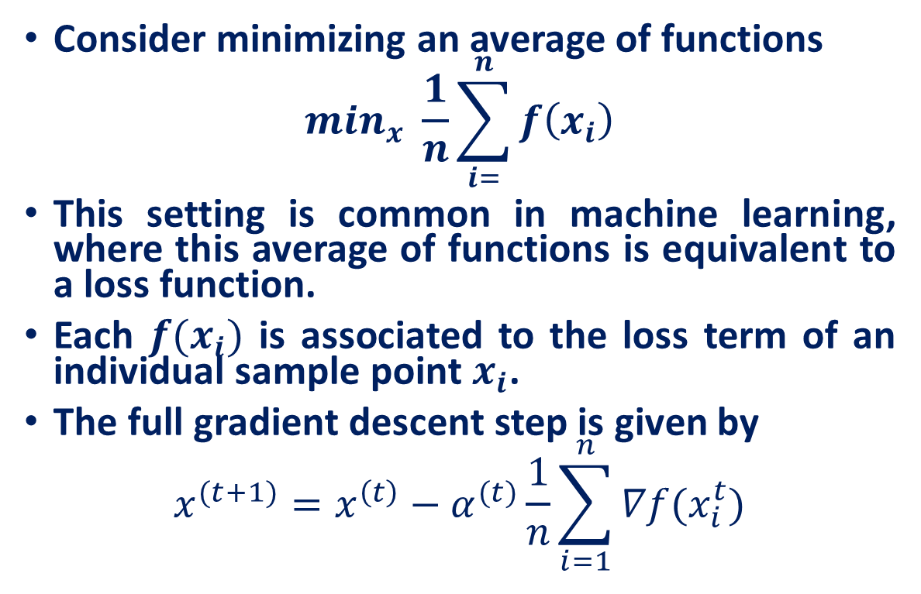
Stochastic Gradient Descent
Consider minimizing an average of functions
$$\min_{x} \frac{1}{n}\sum_{i=}^{n}{f\left(x_{i}\right)}$$
This setting is common in machine learning, where this average of functions is equivalent to a loss function.
Each $f(x_{i})$ is associated to the loss term of an individual sample point $x_{i}$.
The full gradient descent step is given by
$$x^{(t+1)}=x^{\left(t\right)}−α^{(t)}\frac{1}{n}\sum_{i=1}^{n}{∇f(x_{i}^{t})}$$

Slide 20
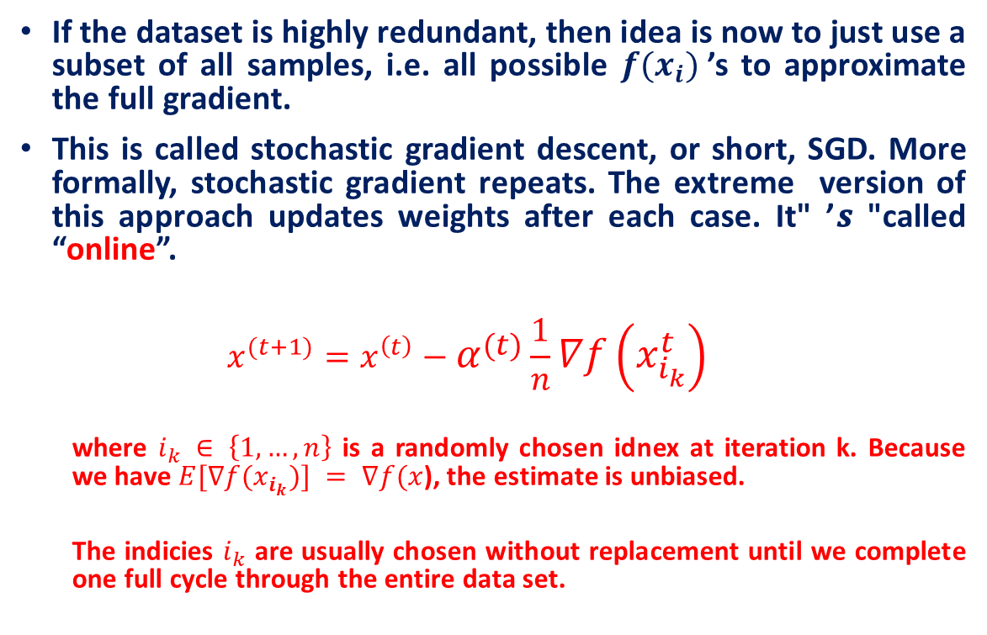
Stochastic Gradient Descent
If the dataset is highly redundant, then idea is now to just use a subset of all samples, i.e. all possible $f(x_{i})$’s to approximate the full gradient.
This is called stochastic gradient descent, or short, SGD. More formally, stochastic gradient repeats. The extreme version of this approach updates weights after each case. It" ’𝒔 "called “online”.
$$x^{(t+1)}=x^{\left(t\right)}−α^{(t)}\frac{1}{n}∇f\left(x_{i_{k}}^{t}\right)$$
where $i_{k} ∈ \left\{1,…,n\right\}$ is a randomly chosen idnex at iteration k. Because we have $E[∇f(x_{i_{k}})] = ∇f(x$), the estimate is unbiased.
The indicies $i_{k}$ are usually chosen without replacement until we complete one full cycle through the entire data set.

Slide 21
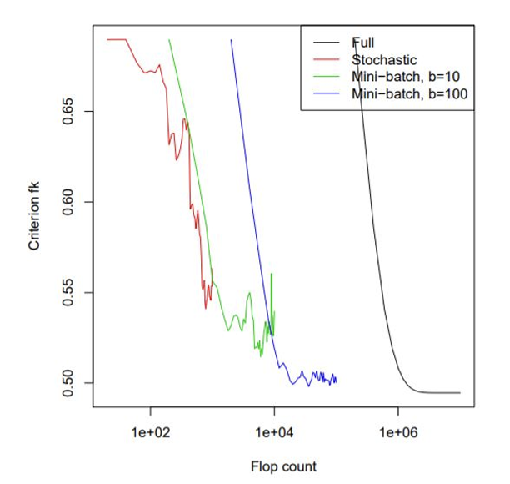
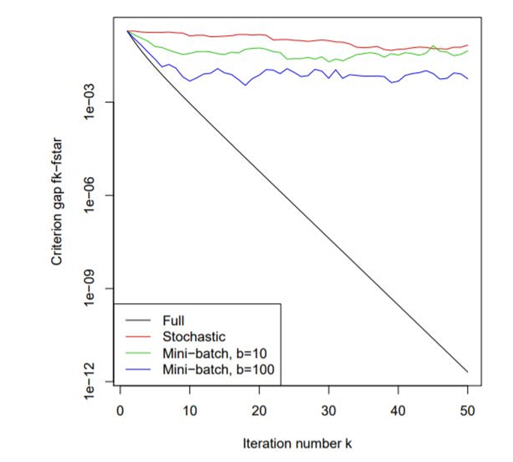
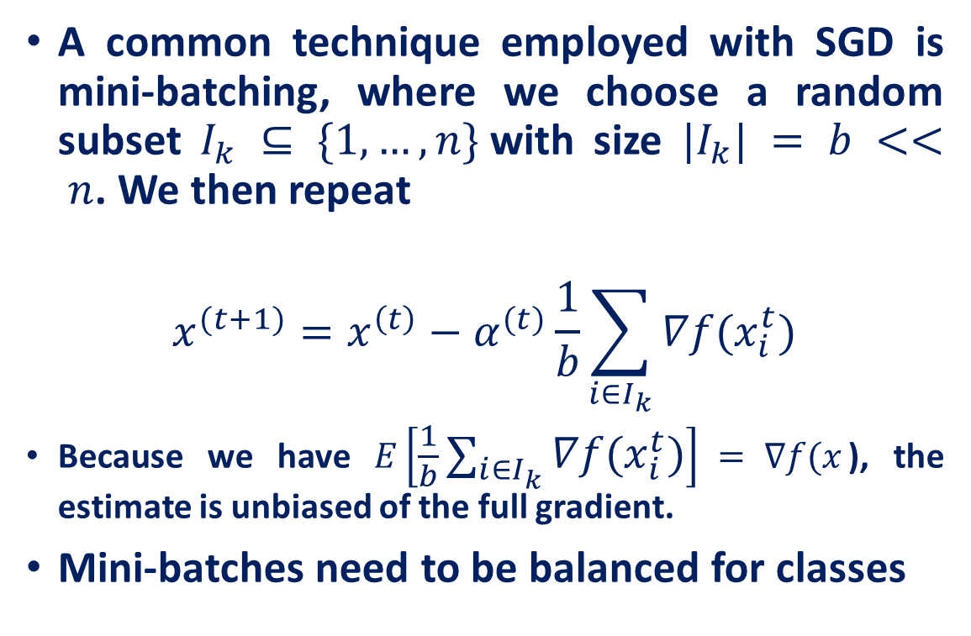
Mini-batching
A common technique employed with SGD is mini-batching, where we choose a random subset $I_{k} ⊆ \{1,…,n\}$with size $|I_{k}| = b << n$. We then repeat
$$x^{(t+1)}=x^{\left(t\right)}−α^{(t)}\frac{1}{b}\sum_{i∈I_{k}}{∇f(x_{i}^{t})}$$
Because we have $E\left[\frac{1}{b}\sum_{i∈I_{k}}{∇f(x_{i}^{t})}\right] = ∇f(x$), the estimate is unbiased of the full gradient.
Mini-batches need to be balanced for classes

Slide 22
Complexity
For a problem with n data points, mini-batch size b and feature dimension d, we obtain the following costs of standard SGD and batch-SGD:
full gradient: O(nd)
mini-batch: O(bd)
standard SGD: O(d)

Slide 23
Some observations about gradient descent
It takes a lot of time to navigate regions having a gentle slope
This is because the gradient in these regions is very small
Can we do something better ?
Yes, let’s take a look at ‘Momentum based gradient descent’

Slide 24
Momentum based Gradient Descent
Intuition
If I am repeatedly being asked to move in the same direction, then I should probably gain some confidence and start taking bigger steps in that direction
Just as a ball gains momentum while rolling down a slope

Slide 25
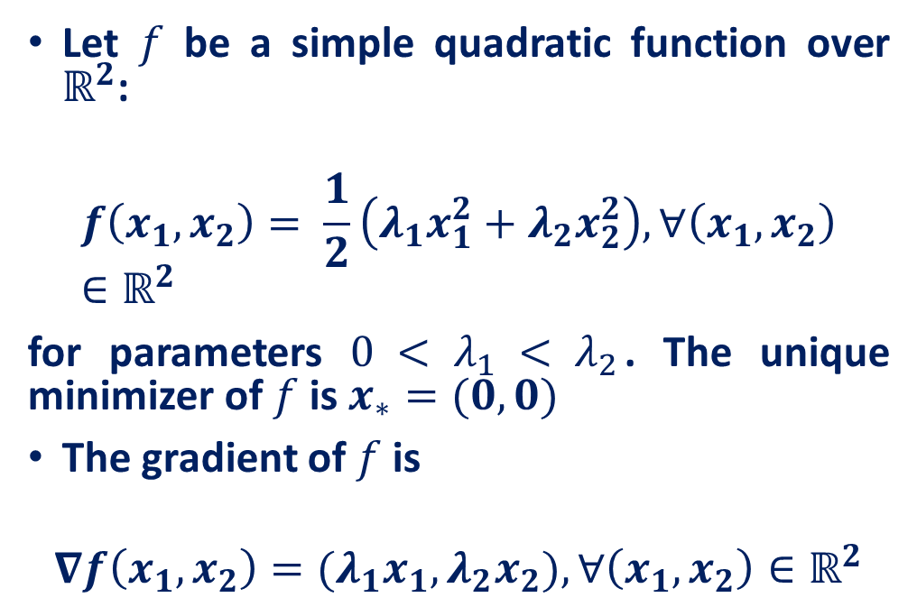
Motivation of momentum
Let $f$ be a simple quadratic function over $ℝ^{2}$:
$$f\left(x_{1},x_{2}\right)= \frac{1}{2}\left(λ_{1}x_{1}^{2}+λ_{2}x_{2}^{2}\right), ∀\left(x_{1},x_{2}\right)∈ℝ^{2}$$
for parameters $0 < λ_{1} < λ_{2}$. The unique minimizer of $f$ is $x_{∗}=(0,0)$
The gradient of $f$ is
$$∇f\left(x_{1},x_{2}\right)=({λ_{1}x}_{1},{λ_{2}x}_{2}),∀\left(x_{1},x_{2}\right)∈ℝ^{2}$$

Slide 26
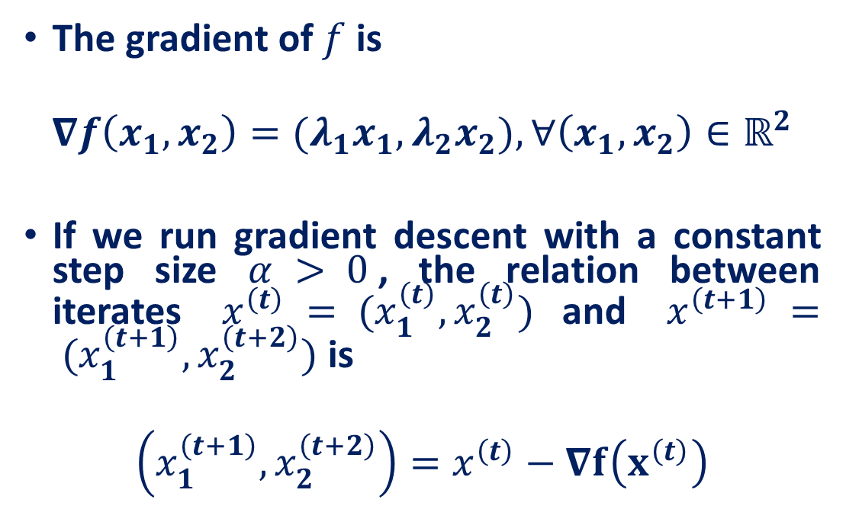
Motivation of momentum
The gradient of $f$ is
$$∇f\left(x_{1},x_{2}\right)=({λ_{1}x}_{1},{λ_{2}x}_{2}),∀\left(x_{1},x_{2}\right)∈ℝ^{2}$$
If we run gradient descent with a constant step size $α > 0$, the relation between iterates $x^{\left(t\right)} = (x_{1}^{\left(t\right)},x_{2}^{\left(t\right)})$and $x^{\left(t+1\right)} = (x_{1}^{\left(t+1\right)},x_{2}^{\left(t+2\right)})$is
$$\left(x_{1}^{\left(t+1\right)},x_{2}^{\left(t+2\right)}\right)=x^{\left(t\right)}−∇f\left(x^{\left(t\right)}\right)$$

Slide 27
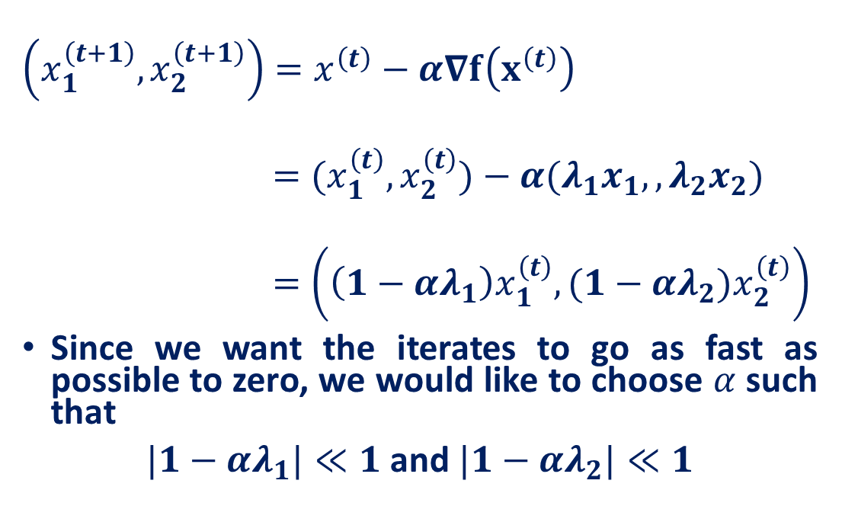
Motivation of momentum
$$\left(x_{1}^{\left(t+1\right)},x_{2}^{\left(t+1\right)}\right)=x^{\left(t\right)}−α∇f\left(x^{\left(t\right)}\right)$$
$$=(x_{1}^{\left(t\right)},x_{2}^{\left(t\right)})−α({λ_{1}x}_{1},,{λ_{2}x}_{2})$$
$$=\left(\left(1−αλ_{1}\right)x_{1}^{\left(t\right)},(1−αλ_{2})x_{2}^{\left(t\right)}\right)$$
Since we want the iterates to go as fast as possible to zero, we would like to choose $α$ such that
$|1−αλ_{1}|≪1$ and $|1−αλ_{2}|≪1$

Slide 28
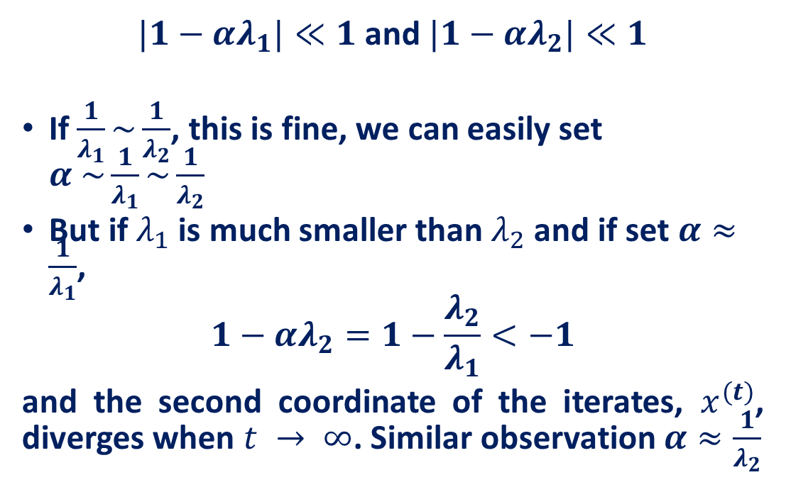
Motivation of momentum
$|1−αλ_{1}|≪1$ and $|1−αλ_{2}|≪1$
If $\frac{1}{λ_{1}}\sim \frac{1}{λ_{2}}$, this is fine, we can easily set $α \sim \frac{1}{λ_{1}}\sim \frac{1}{λ_{2}}$
But if $λ_{1}$ is much smaller than $λ_{2}$ and if set $α≈\frac{1}{λ_{1}}$,
$$1−αλ_{2}=1−\frac{λ_{2}}{λ_{1}}<−1$$
and the second coordinate of the iterates, $x^{(t)}$, diverges when $t → ∞$. Similar observation $α≈\frac{1}{λ_{2}}$

Slide 29
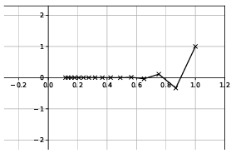

Motivation of momentum
In this situation, gradient descent is slow.
Till iteration 15 with $λ_{1} = 0.1$and $λ_{2} = 1$, for $α =\frac{4}{3}$
Now, the convergence will be too slow

Slide 30
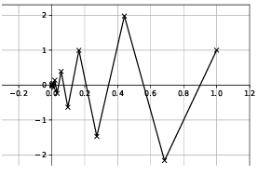
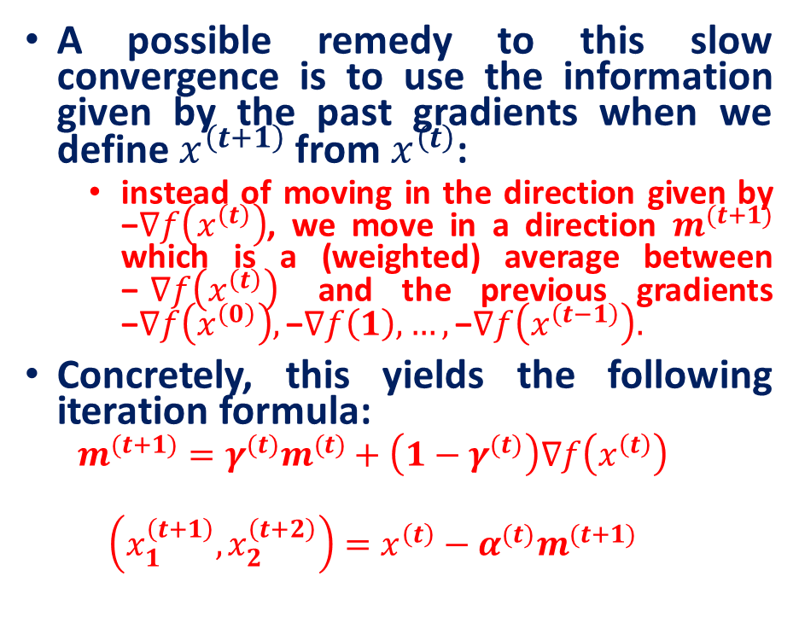
Momentum based Gradient Descent
A possible remedy to this slow convergence is to use the information given by the past gradients when we define $x^{\left(t+1\right)}$from $x^{\left(t\right)}$:
instead of moving in the direction given by −$∇f\left(x^{\left(t\right)}\right)$, we move in a direction $m^{(t+1)}$ which is a (weighted) average between −$∇f\left(x^{\left(t\right)}\right)$ and the previous gradients −$∇f\left(x^{\left(0\right)}\right),\text{−}∇f\left(1\right), …,\text{−}∇f\left(x^{\left(t−1\right)}\right).$
Concretely, this yields the following iteration formula:
$$m^{(t+1)}={γ^{(t)}m}^{(t)}+\left({1−γ}^{(t)}\right)∇f\left(x^{\left(t\right)}\right)$$
$$\left(x_{1}^{\left(t+1\right)},x_{2}^{\left(t+2\right)}\right)=x^{\left(t\right)}−α^{(t)}m^{(t+1)}$$

Slide 31
Some observations and questions
Even in the regions having gentle slopes, momentum-based gradient descent can take large steps because the momentum carries it along
Is moving fast always good? Would there be a situation where momentum would cause us to run pass our goal?
Momentum based gradient descent oscillates in and out of the minima valley as the momentum carries it out of the valley
Despite oscillations, it still converges faster than vanilla gradient descent

Slide 32
Adaptive Sub-Gradient Method
Adaptive methods adjust the learning rate for each parameter individually based on the history of the gradients.
The idea is to give frequently occurring features a smaller learning rate and infrequent features a larger learning rate.
Variants:
AdaGrad: Accumulates the square of the gradients over time and uses this information to scale the learning rate for each parameter. It works well for sparse data but tends to make the learning rate too small over time.
RMSProp: Modifies AdaGrad by using an exponentially decaying average of squared gradients instead of a cumulative sum, which helps to prevent the learning rate from decaying too much.
Adam: Combines the ideas of momentum and RMSProp. It uses running averages of both the gradients and their squares, making it one of the most widely used optimizers.

Slide 33
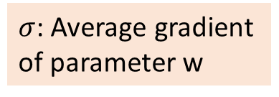
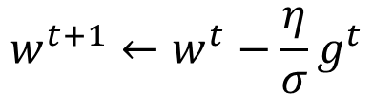


Adagrad
Divide the learning rate by “average” gradient
High-dimensional non-convex nature of neural networks optimization could lead to different sensitivity on each dimension.
The learning rate could be too small in some dimension and could be too large in another dimension.
$$w^{t+1}←w^{t}−\frac{η}{σ}g^{t}$$
$σ$: Average gradient of parameter w
Estimated while updating the parameters
If $w$ has small average gradient $σ$
Larger learning rate
If $w$ has large average gradient $σ$
Smaller learning rate

Slide 34
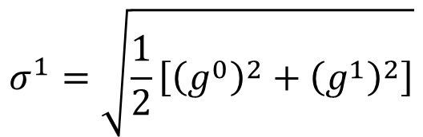
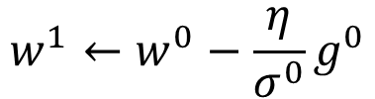

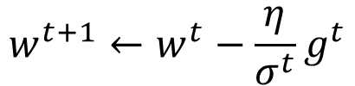
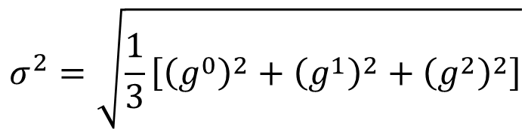
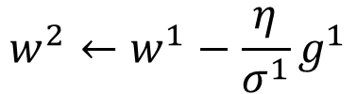
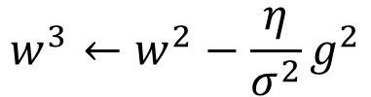

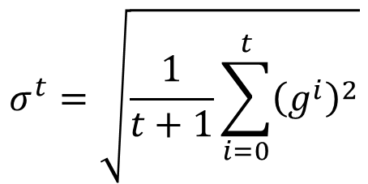
Adagrad
$$w^{1}←w^{0}−\frac{η}{σ^{0}}g^{0}$$
$$σ^{0}=g^{0}$$
$$σ^{1}=\sqrt{\frac{1}{2}\left[{\left(g^{0}\right)}^{2}+{\left(g^{1}\right)}^{2}\right]}$$
$$w^{2}←w^{1}−\frac{η}{σ^{1}}g^{1}$$
$$σ^{2}=\sqrt{\frac{1}{3}\left[{\left(g^{0}\right)}^{2}+{\left(g^{1}\right)}^{2}+{\left(g^{2}\right)}^{2}\right]}$$
$$w^{3}←w^{2}−\frac{η}{σ^{2}}g^{2}$$
$$……$$
$$σ^{t}=\sqrt{\frac{1}{t+1}\sum_{i=0}^{t}{{\left(g^{i}\right)}^{2}}}$$
$$w^{t+1}←w^{t}−\frac{η}{σ^{t}}g^{t}$$
Notes:
Why square

Slide 35



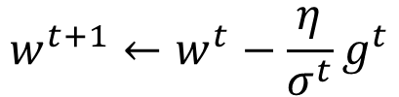
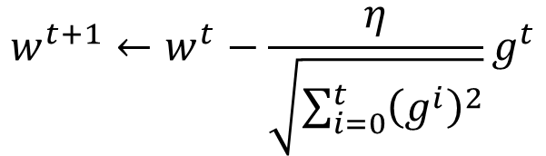
Adagrad
Divide the learning rate by “average” gradient
The “average” gradient is obtained while updating the parameters
$$σ^{t}=\sqrt{\frac{1}{t+1}\sum_{i=0}^{t}{{\left(g^{i}\right)}^{2}}}$$
$$η_{t}$$
$$w^{t+1}←w^{t}−\frac{η}{σ^{t}}g^{t}$$
$$η_{t}=\frac{η}{\sqrt{t+1}}$$
$$w^{t+1}←w^{t}−\frac{η}{\sqrt{\sum_{i=0}^{t}{{\left(g^{i}\right)}^{2}}}}g^{t}$$
1/t decay

Slide 36


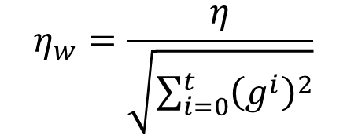
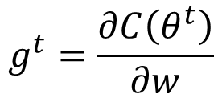
Adagrad
Original Gradient Descent
$$θ^{t}←θ^{t−1}−η∇C\left(θ^{t−1}\right)$$
Each parameter w are considered separately
$$g^{t}=\frac{∂C\left(θ^{t}\right)}{∂w}$$
$$w^{t+1}←w^{t}−{\text{η}}_{w}g^{t}$$
Parameter dependent learning rate
constant
$${\text{η}}_{w}=\frac{η}{\sqrt{\sum_{i=0}^{t}{{\left(g^{i}\right)}^{2}}}}$$
Summation of the square of the previous derivatives

Slide 37
Acknowledgement
http://wavelab.uwaterloo.ca/wp-content/uploads/2017/04/Lecture_3.pdf
https://heartbeat.fritz.ai/deep-learning-best-practices-regularization-techniques-for-better-performance-of-neural-network-94f978a4e518
https://cedar.buffalo.edu/~srihari/CSE676/7.12%20Dropout.pdf
http://speech.ee.ntu.edu.tw/~tlkagk/courses/ML_2017/Lecture/DNN%20tip.pptx
Accelerating Deep Network Training by Reducing Internal Covariate Shift, Jude W. Shavlik
http://speech.ee.ntu.edu.tw/~tlkagk/courses/MLDS_2018/Lecture/ForDeep.pptx
Deep Learning Tutorial. Prof. Hung-yi Lee, NTU.
On Predictive and Generative Deep Neural Architectures, Prof. Swagatam Das, ISICAL

